Slide 1
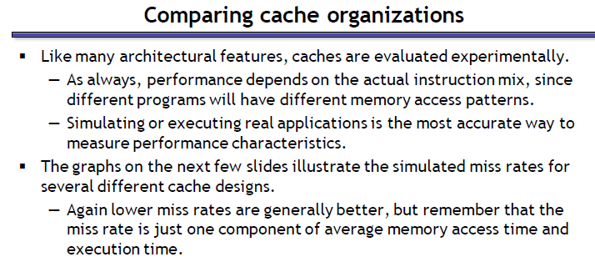

Slide 2
Cache Misses
Compulsory (cold start or process migration, first reference): first access to a block
“Cold” fact of life: not a whole lot you can do about it
Note: If you are going to run “billions” of instruction, Compulsory Misses are insignificant
Capacity:
Cache cannot contain all blocks access by the program
Solution: increase cache size
Conflict (collision):
Multiple memory locations mapped to the same cache location
Solution 1: increase cache size
Solution 2: increase associativity

Slide 3
Reduce Miss Rate
Increase block-size
Reduction in compulsory miss(special locality)
May increase capacity miss if cache size is small
May increase conflict misses
Larger Cache size
Reduce capacity miss
Reduce conflict miss
Increase cost of memory
Higher Associativity
Reduce conflict miss
Increase cost of memory
Victim Cache
Is a small fully associative cache which contains blocks(victims) that were discarded recently from cache. If these victim blocks are immediately required after the present word, victim block and cache block are swapped
Compiler Optimizations-(next slide)

Slide 4
Compiler Optimizations to Reduce Miss Rate
 | Before | After
Loop Fusion | for(i=0; i<N ; i++) for(j=0; j<N; j++) a[i][j]=1/b[i][j]*c[i][j]; for(i=0; i<N ; i++) for(j=0; j<N; j++) d[i] [j]=a[i][j] + c[i][j]; | for(i=0; i<N ; i++) for(j=0; j<N; j++) { a[i][j]=1/b[i][j]*c[i][j]; d[i] [j]=a[i][j] + c[i][j]; } Improved temporal locality
Loop Interchange | for(j=0; <100 ; j++) for(i=0; i<2000; i++) x[i][j]=2*x[i][j]; Skips through memory in strides of 100 words | for(i=0; i<2000; i++) for(j=0; <100 ; j++) x[i][j]=2*x[i][j]; Accesses all the words of cache block before going to next one
Merge Array | int val[SIZE];int key[SIZE]; | struct d{ int val;int key; }; struct d d_arr[SIZE]; Improved spatial locality

Slide 5
What is Miss Penalty ? --extra time needed to bring required block from main memory to cache in case of cache miss is called Miss Penalty
Reducing Miss Penalty
Faster RAM memories
Driven by technology and cost !!!
Eg: CRAY uses only SRAM
Use write buffers ( next slide)
Multi-level cache (L1,L2..)
Early restart
On cache miss memory sends requested word to CPU then the remainder of the block is copied to cache.
Priority of reads over write( make more common case fast)

Slide 6
Reducing Miss Penalty [contd…]
Cache
Processor
DRAM
Write Buffer
A Write Buffer is needed between the Cache and Memory
Processor: writes data into the cache and the write buffer
Memory controller: write contents of the buffer to memory
Write buffer is just a FIFO:

Slide 7
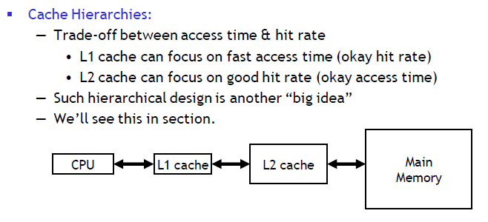
Reduce Hit Time

Slide 8
Summary
The Principle of Locality:
Program likely to access a relatively small portion of the address space at any instant of time.
Temporal Locality: Locality in Time
Spatial Locality: Locality in Space
Three Major Categories of Cache Misses:
Compulsory Misses: sad facts of life. Example: cold start misses.
Conflict Misses: increase cache size and/or associativity. Nightmare Scenario: ping pong effect!
Capacity Misses: increase cache size
Cache Design Space
total size, block size, associativity
replacement policy
write-hit policy (write-through, write-back)
write-miss policy

